Slide 1
Weekly Work Update
Image To Words – 20th November
Horatiu Ilie

Slide 2
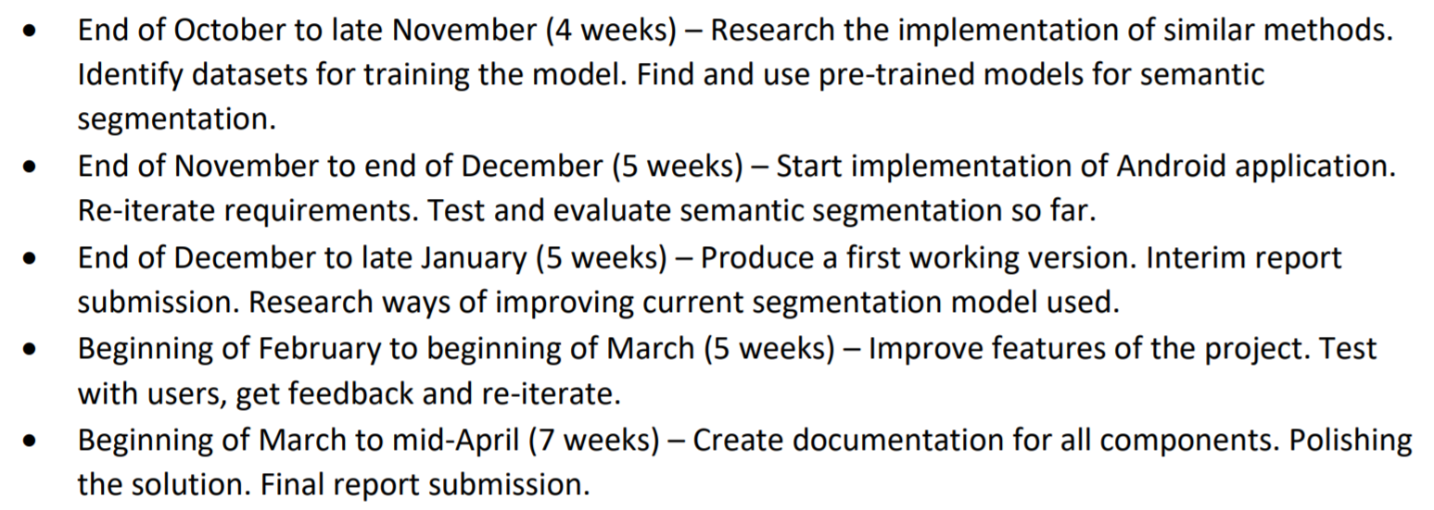
Project Plan
Created first version
Submitted and confirmed
Rough idea of how to split work load

Slide 3
Papers To Read
Fully Convolutional Networks for Semantic Segmentation
Jonathan Long, Evan Shelhamer, Trevor Darrell
The IEEE Conference on Computer Vision and Pattern, 2015
Access here
A Review on Deep Learning Techniques Applied to Semantic Segmentation
A. Garcia-Garcia, S. Orts-Escolano, S.O. Oprea, V. Villena-Martinez, and J. Garcia-Rodriguez
arXiv:1704.06857v1, 2017
Access here

Slide 4
Faster-RCNN with VGG
Downloaded VGG pre-trained
Downloaded NYU
Started building modified model
Change final layer in VGG
Convert to from Matlab to Python required
Not yet retrained my new layer

